Slide 1
Network and Information Security
Michael Adjeisah
Email：madjeisah@zjnu.edu.cn

Slide 2
Syllabus
This course makes use of multiple programming languages including Java, python, JavaScript and PHP, and computing environment such as Windows, Ubuntu, and Kali.
Prerequisites
Networking and Data Communications
Algorithms
Web Technology

Slide 3
Course Grade
Homework and Class Participation 20%
2 Quizzes, 20%
Lab Exercises, 25%
Final Project and Presentation (final exam), 35%
Attention: Lab exercises will be graded on the correctness based on both the lab assignment and whether they fulfill the specifications imposed by the grading / checking scripts.

Slide 4

Open Resource
https://github.com/Madjeisah/Network-Information-Security
Joseph Migga Kizza. Guide to Computer
Network Security, 4th edition. Springer, 2017.
William Stallings. Cryptography and Network
Securuty: Principle and Practice, 5th edition. Pearson, 2010.

Slide 5

Overview of Computer Network Security
Introduction
What’s distributed system？
What is distributed system security?
Why do we need security?
Security Services
Common security attacks and countermeasures (Week 2)
Firewalls & Intrusion Detection Systems
Denial of Service Attacks
TCP Attacks
Packet Sniffing
Social Problems

Slide 6
Overview
Introduction
What’s distributed system？
What is distributed system security?
Why do we need security?
Security Services
Common security attacks and countermeasures
Firewalls & Intrusion Detection Systems
Denial of Service Attacks
TCP Attacks
Packet Sniffing
Social Problems

Slide 7
Objective
To understand computer network and network models
To define three security goals
To define security attacks that threaten security goals
To define security services and how they are related to the three security goals
To define security mechanisms to provide security services
Notes:
To introduce two techniques, cryptography and steganography, to implement security mechanisms.

Slide 8
What is Computer Network
A computer network is a distributed system consisting of loosely coupled computers and other devices. Any two of these devices, are refer to as network elements or transmitting elements, and can communicate with each other through a communication medium.
Three significant structure of communication :
First, there must be two entities, a sender and a receiver.
Second, there must be a medium through which the sharable item is channeled. This is the transmission medium
Finally, there must be an agreed-on set of communication rules or protocols.

Slide 9
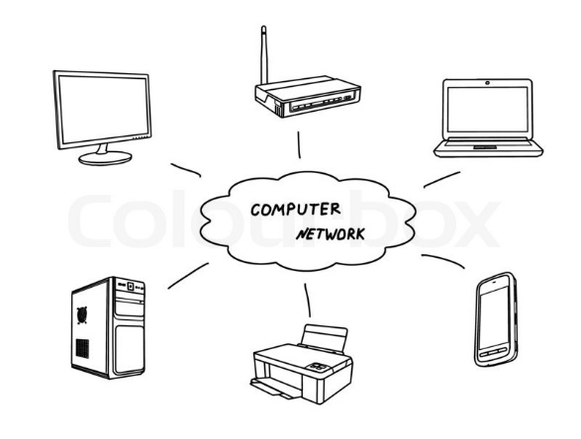
What is Computer Network
The resulting combination consisting of hardware and software is a computer communication network or computer network. The hardware component is made of network elements consisting of
a collection of nodes that include the end systems commonly called hosts and
intermediate switching elements that include hubs, bridges, routers, and gateways.

Slide 10
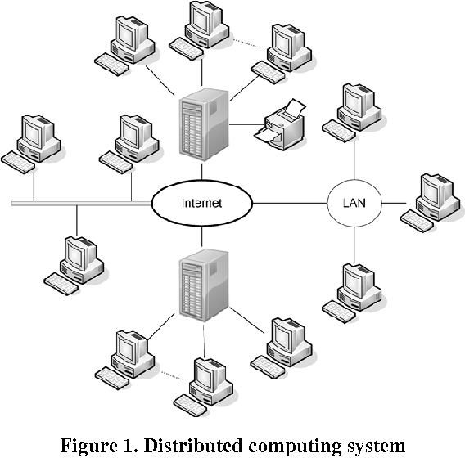
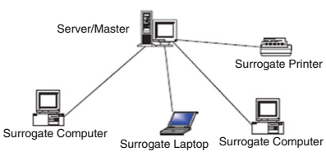
What is Computer Network Models
The most common network configuration models of these are the centralized and distributed models
centralized : there is only one central computer or the master, through which all correspondence must take place.
distributed : consists of loosely coupled computers interconnected by a communication network consisting of connecting elements and communication channels.

Slide 11
Computer Network Types
Two main network types: the local area network (LAN) and wide area network (WAN).
Between the LAN and WAN, there is also a middle network called the metropolitan area network (MAN)

Slide 12
Data Communication Media Technology
The performance of a network type depends greatly on the transmission technology and media used in the network
Transmission Technology:
Analog Encoding of Digital Data
Digital Encoding of Digital Data
Multiplexing of Transmission Signals
Transmission Media
Wired Transmission Media
Wireless Communication

Slide 13
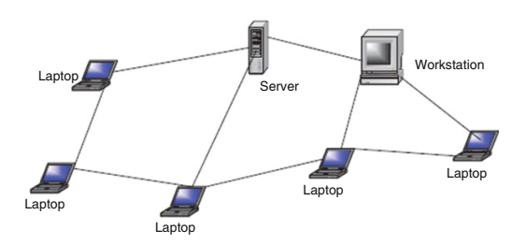
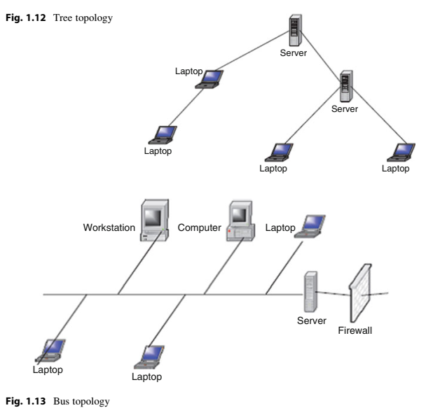
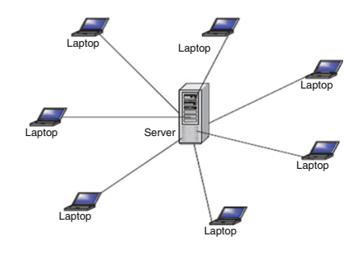
Network Topology
Computer networks, whether LANs, MANs, or WANs, are constructed based on a topology. There are several topologies including the following popular ones.
Mesh
Tree
Bus
Star
Ring
Ring?

Slide 14
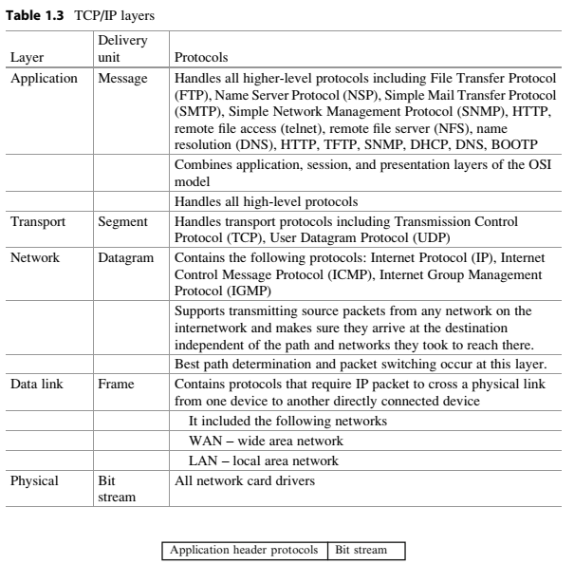
Network Connectivity and Protocols
Open Systems Interconnection (OSI) model
Transmission Control Protocol/Internet Protocol (TCP/IP) Model

Slide 15
Overview
Introduction
What’s distributed system？
What is distributed system security?
Why do we need security?
Security Services
Common security attacks and countermeasures
Firewalls & Intrusion Detection Systems
Denial of Service Attacks
TCP Attacks
Packet Sniffing
Social Problems

Slide 16
What’s Distributed System
A distributed system is a software system in which components located on networked computers communicate and coordinate their actions by passing messages. The components interact with each other in order to achieve a common goal.
Three significant characteristics of distributed systems are:
concurrency of components
lack of a global clock
independent failure of components

Slide 17
Reasons for using distributed systems
The very nature of an application may require the use of a communication network that connects several computers.
E.g., data produced in one physical location and required in another location.

Slide 18
Reasons for using distributed systems
There are many cases in which the use of a single computer would be possible in principle, but the use of a distributed system is beneficial for practical reasons.
It may be more cost-efficient to obtain the desired level of performance by using a cluster of several low-end computers, in comparison with a single high-end computer.
A distributed system can provide more reliability than a non-distributed system, as there is no single point of failure.
Moreover, a distributed system may be easier to expand and manage than a monolithic uniprocessor system.

Slide 19
Examples of distributed systems(1/2)
Telecommunication networks
telephone networks and cellular networks,
computer networks such as the Internet,
wireless sensor networks,
Network applications
world wide web and peer-to-peer networks,
massively multiplayer online games and virtual reality communities,
distributed databases and management systems,
network file systems,
distributed information processing systems such as banking systems and airline reservation systems;

Slide 20
Examples of distributed systems(2/2)
Real-time process control:
aircraft control systems,
industrial control systems;
Parallel computation:
scientific computing, including cluster computing and grid computing and various volunteer computing projects
distributed rendering in computer graphics.

Slide 21
Examples of distributed computing
Grid Computing
Peer-to-Peer Computing
Services Computing
Pervasive/Ubiquitous Computing
Cloud Computing
Autonomous Computing
Edge Computing
Mobile Computing
Sensor Network
Block Chain
……

Slide 22
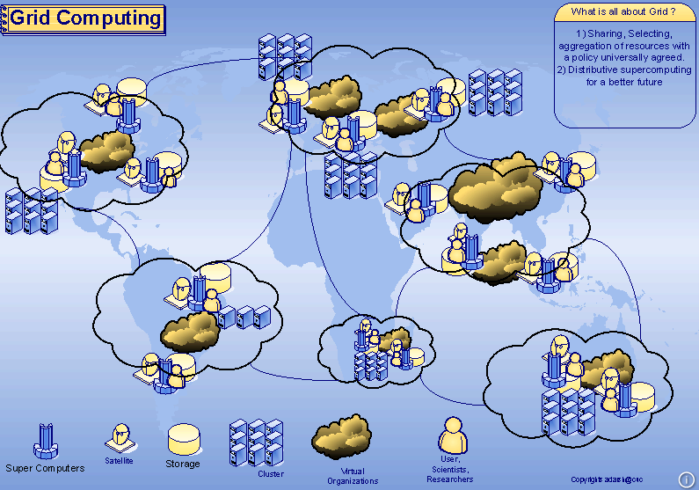
Grid Computing

Slide 23
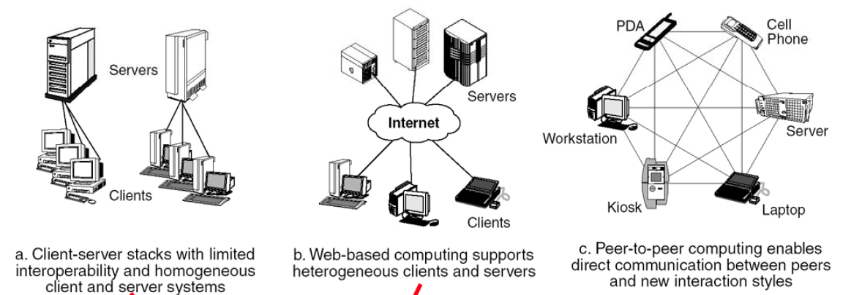
Peer-to-Peer Computing

Slide 24
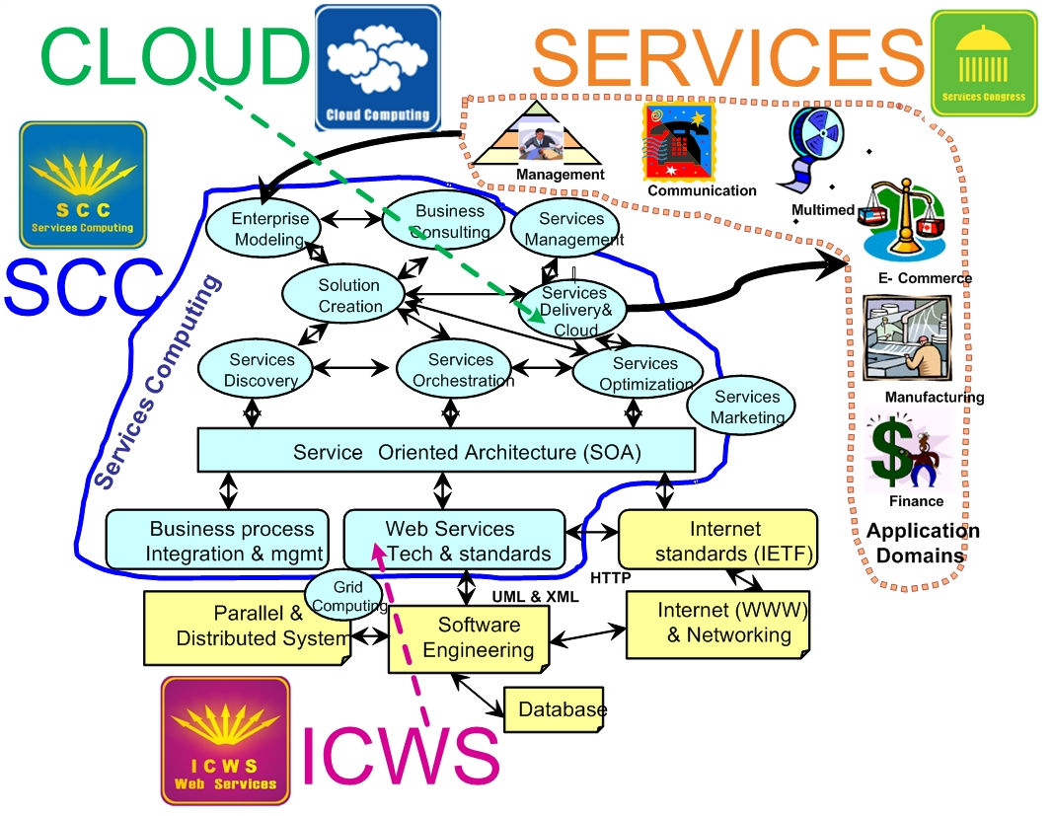
Services Computing
Services Computing has become a cross-discipline that covers the science and technology of bridging the gap between business services and IT services.

Slide 25
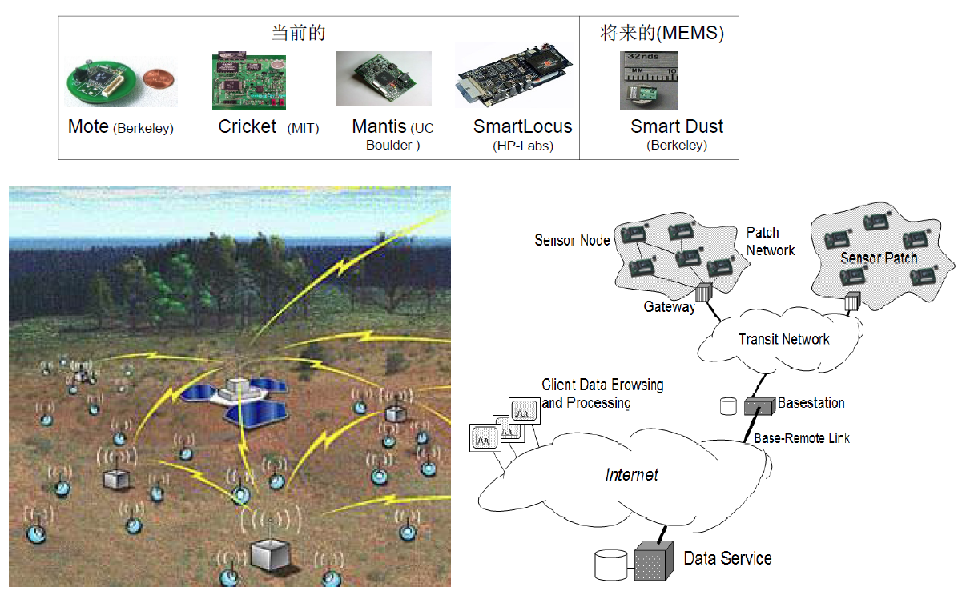
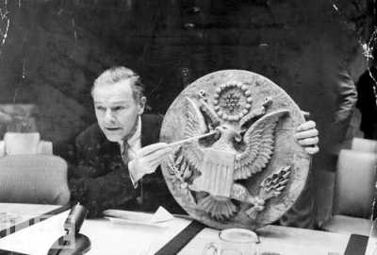
Sensor Network
Gold lip action
(The Soviet Union V.S. USA)

Slide 26
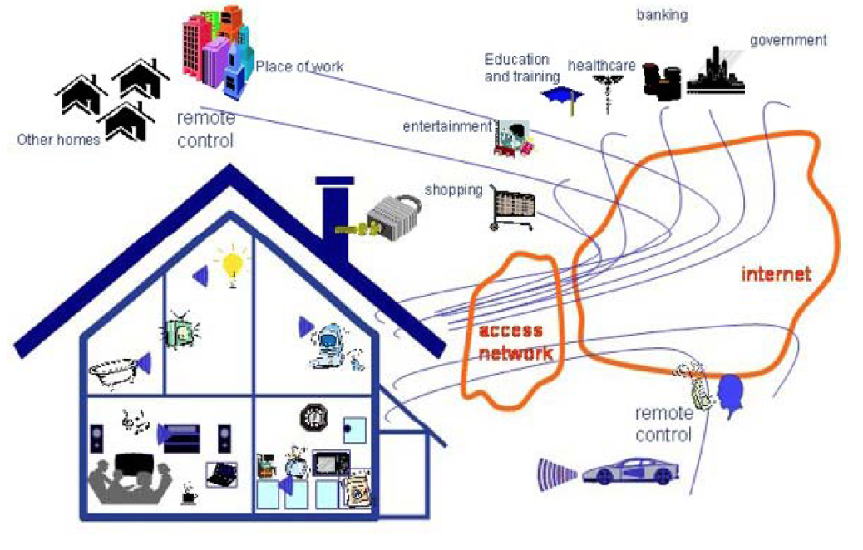
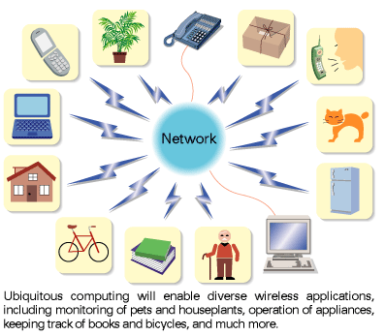
Pervasive/Ubiquitous Computing

Slide 27
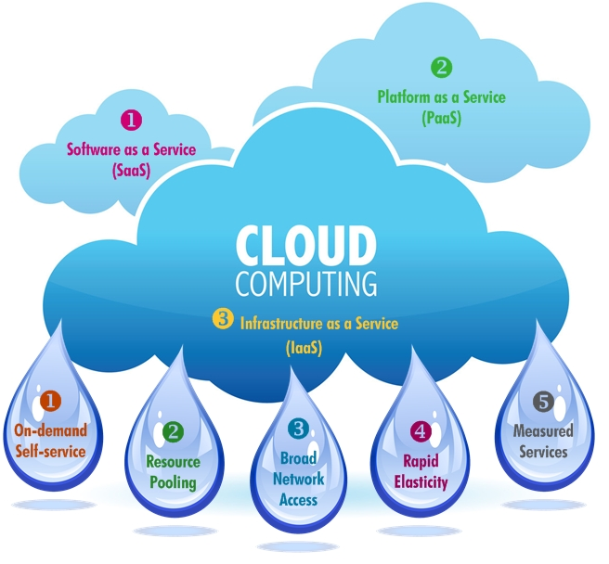
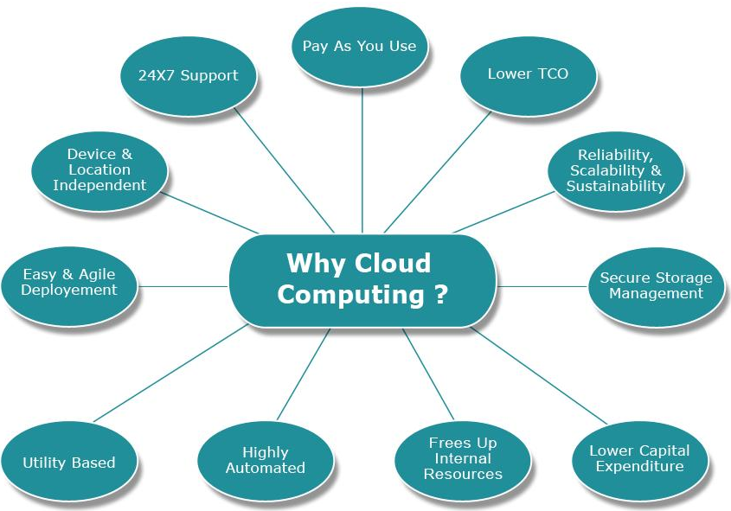
Cloud Computing

Slide 28
Overview
Introduction
What’s distributed system？
What is distributed system security?
Why do we need security?
Security Services
Common security attacks and countermeasures
Firewalls & Intrusion Detection Systems
Denial of Service Attacks
TCP Attacks
Packet Sniffing
Social Problems

Slide 29
What is “Security”
Dictionary.com says:
1. Freedom from risk or danger; safety.
2. Freedom from doubt, anxiety, or fear; confidence.
3. Something that gives or assures safety, as:
A group or department of private guards: Call building security if a visitor acts suspicious.
Measures adopted by a government to prevent espionage, sabotage, or attack.
Measures adopted by a business or homeowner, to prevent a crime such as burglary or assault: Security was lax at the firm's smaller plant.
…etc.
Security is a continuous process of protecting an object from unauthorized access. It is as state of being or feeling protected from harm.

Slide 30
What is “Security”
Security can be guaranteed if the following four protection mechanisms are in place:
Deterrence is usually the first line of defense against intruders who may try to gain access. It works by creating an atmosphere intended to frighten intruders. Sometimes this may involve warnings of severe consequences if security is breached.
Prevention is the process of trying to stop intruders from gaining access to the resources of the system. Barriers include firewalls, demilitarized zones (DMZs), and the use of access items like keys, access cards, biometrics, and others to allow only authorized users to use and access a facility.

Slide 31
What is “Security”
Detection occurs when the intruder has succeeded or is in the process of gaining access to the system. Signals from the detection process include alerts to the existence of an intruder. Sometimes, these alerts can be real time or stored for further analysis by the security personnel.
Response is an aftereffect mechanism that tries to respond to the failure of the first three mechanisms. It works by trying to stop and/or prevent future damage or access to a facility

Slide 32
What’s Distributed System Security(1/2)
Distributed System Security Architecture or (DSSA) is a computer security architecture that provides a suite of functions including login, authentication, and access control in a distributed system. To differ from other similar architectures, the DSSA architecture offers the ability to access all these functions without the trusted server (known as a certificate authority) being active.

Slide 33
What’s Distributed System Security(2/2)
Security = Sustain desirable properties under intelligent adversaries
Desirable properties
Understand what properties are needed.
Intelligent adversaries
Needs to understand/model adversaries
Always think about adversaries.
Notes:
Differs from fault tolerance in that faults are random, and attacks are intelligently carried out.

Slide 34
Overview
Introduction
What’s distributed system？
What is distributed system security?
Why do we need security?
Security Services
Common security attacks and countermeasures
Firewalls & Intrusion Detection Systems
Denial of Service Attacks
TCP Attacks
Packet Sniffing
Social Problems

Slide 35
Why do we need security?
Protect vital information while still allowing access to those who need it
Trade secrets, medical records, etc.
Provide authentication and access control for resources
Ex: operation system
Guarantee availability of resources
Ex: “five 9’s” (99.999% reliability)
Notes:
Nines are a unit of measurement used to describe the reliability of a system or process. The term “five 9s” refers to a reliability level of 99.999%. This means that the system or process in question is operational 99.999% of the time

Slide 36
Security is increasingly important

Slide 37
Security mindset
Learn to think with a “security mindset” in general
What is “the system”?
What is the weakest point of attack?
What threats am I trying to address?
How effective will a given countermeasure be?
What is the trade-off between security, cost, and usability?
Remember: Computer security is not just about computers
Physical security
Social engineering
1. Bribes for passwords 2. Malicious code in email attachments
External” means of getting information
1. Legal records 2. Trash cans

Slide 38
Is security the answer?
Given the inherent tradeoffs, it seems that almost all deployed systems will have some vulnerability
“More security” is not a sufficient answer
Detection and response
How do you know when you are being attacked?
How quickly can you stop the attack?
Can you prevent the attack from recurring?
Recovery
Can be much more important than prevention
Security is a process, not a product…

Slide 39
Who is vulnerable?
Financial institutions and banks
Internet service providers
Pharmaceutical companies
Government and defense agencies
Contractors to various government agencies
Multinational corporations
ANYONE ON THE NETWORK

Slide 40
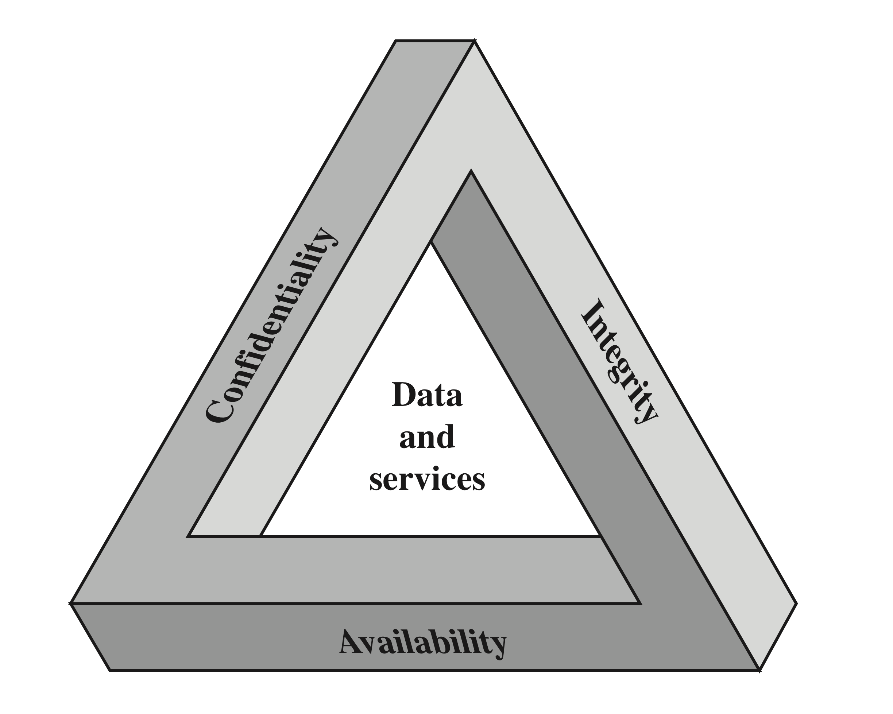
Security Goals/Properties (C, I, A)
Confidentiality
Data confidentiality - Can you keep a secret?
Assures that private or confidential information is not made available or disclosed to unauthorized individuals
Privacy
Assures that individuals control or influence what information related to them may be collected and stored and by whom and to whom that information may be disclosed
Integrity
Availability
Assures that systems work promptly and service is not denied to authorized users
Assures that a system performs its intended function in an unimpaired manner, free from deliberate or inadvertent unauthorized manipulation of the system
System integrity
Assures that information and programs are changed only in a specified and authorized manner
Data integrity - Did you get the message I sent?
Are you there when needed?

Slide 41
Security Threat Motives
Who are the attackers?
bored teenagers, criminals, organized crime organizations, rogue (or other) states, industrial espionage, angry employees, …
Why they do it?
Fun//Notoriety, Terrorism, Vendetta/Revenge, Hate (National Origin, Gender, and Race), Greed, Ignorance, Targeting the National Information Infrastructure
Fame,
profit, …
computer systems are where the moneys are
Political/military objectives
Economic Espionage

Slide 42
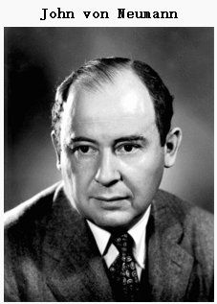
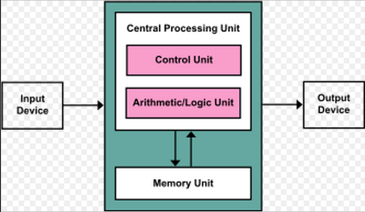
Why These Attacks Can Succeed?
Software/computer/information systems/designs are buggy
They are complex, dynamic, and increasingly so
Users make mistakes
Some Technological factors
Von Neumann architecture: stored programs mixing code and data
Unsafe program languages
Notes:
A computer is a general purpose device that can be programmed to carry out a set of arithmetic or logical operations automatically.
What makes computers powerful? They are programmable. It is not designed to do one thing, but rather to execute any program.
Why Turing Machine was considered a theoretical foundation for computer science. There exists a universal Turing Machine.
Von Neumann architecture. Data can change into code.
Computers do things that they are told to do.
One desires more and more interaction
Making things secure are hard
Security may make things harder to use

Slide 43
Why Do These Factors Exist?
Economical factors
Lack of incentives for secure software
Security is difficult, expensive and takes time
Human factors
Lack of security training for software engineers
Largely uneducated population
Notes:
Human factor. Analogy with security in the physical world.

Slide 44
Security is Interesting
The most interesting/challenging threats to security are posed by human adversaries.
Distributed system security is a self-sustaining field that can work both from attack perspective and from defense perspective.
Security is about benefit/cost tradeoff that thought often the tradeoff analysis is not explicit.
Security is not all technological, as humans are often the weakest link.

Slide 45
Security is Challenging
Defense is almost always harder than attack.
adversaries can come from anywhere
computers enable large-scale automation
adversaries can be difficult to identify
adversaries can be difficult to punish
potential payoff can be much higher
Notes:
Which ways information security is easier than physical security?
More well-defined entry points.
Lower cost of deploying high-quality security mechanisms.
E.g., cryptography

Slide 46
Breach of Security Levels of Impact
High
The loss could be expected to have a severe or catastrophic adverse effect on organizational operations, organizational assets, or individuals
Moderate
The loss could be expected to have a serious adverse effect
Low
The loss could be expected to have a limited adverse effect
Notes:
We use three levels of impact on organizations or
individuals should there be a breach of security (i.e., a loss of confidentiality, integrity,
or availability). These levels are defined in FIPS PUB 199:
• Low: The loss could be expected to have a limited adverse effect on organizational
operations, organizational assets, or individuals. A limited adverse
effect means that, for example, the loss of confidentiality, integrity, or availability
might (i) cause a degradation in mission capability to an extent and
duration that the organization is able to perform its primary functions, but the
effectiveness of the functions is noticeably reduced; (ii) result in minor damage
to organizational assets; (iii) result in minor financial loss; or (iv) result in
minor harm to individuals.
• Moderate: The loss could be expected to have a serious adverse effect on
organizational operations, organizational assets, or individuals. A serious
adverse effect means that, for example, the loss might (i) cause a significant
degradation in mission capability to an extent and duration that the
organization is able to perform its primary functions, but the effectiveness
of the functions is significantly reduced; (ii) result in significant damage to
organizational assets; (iii) result in significant financial loss; or (iv) result in
significant harm to individuals that does not involve loss of life or serious,
life-threatening injuries.
• High: The loss could be expected to have a severe or catastrophic adverse
effect on organizational operations, organizational assets, or individuals.
A severe or catastrophic adverse effect means that, for example, the loss might
(i) cause a severe degradation in or loss of mission capability to an extent and
duration that the organization is not able to perform one or more of its primary
functions; (ii) result in major damage to organizational assets; (iii) result
in major financial loss; or (iv) result in severe or catastrophic harm to individuals
involving loss of life or serious, life-threatening injuries.

Slide 47
OSI Security Architecture
Security attack
Any action that compromises the security of information owned by an organization
Security mechanism
A process (or a device incorporating such a process) that is designed to detect, prevent, or recover from a security attack
Security service
A processing or communication service that enhances the security of the data processing systems and the information transfers of an organization
Intended to counter security attacks, and they make use of one or more security mechanisms to provide the service
Notes:
To assess effectively the security needs of an organization and to evaluate and
choose various security products and policies, the manager responsible for computer
and network security needs some systematic way of defining the requirements
for security and characterizing the approaches to satisfying those requirements.
This is difficult enough in a centralized data processing environment; with the use of
local and wide area networks, the problems are compounded.
ITU-T Recommendation X.800, Security Architecture for OSI , defines such a
systematic approach. The OSI security architecture is useful to managers as a way
of organizing the task of providing security. Furthermore, because this architecture
was developed as an international standard, computer and communications vendors
have developed security features for their products and services that relate to this
structured definition of services and mechanisms.
For our purposes, the OSI security architecture provides a useful, if abstract,
overview of many of the concepts that this book deals with. The OSI security architecture
focuses on security attacks, mechanisms, and services. These can be defined
briefly as
• Security attack: Any action that compromises the security of information
owned by an organization.
• Security mechanism: A process (or a device incorporating such a process) that
is designed to detect, prevent, or recover from a security attack.
• Security service: A processing or communication service that enhances the
security of the data processing systems and the information transfers of an
organization. The services are intended to counter security attacks, and they
make use of one or more security mechanisms to provide the service.

Slide 48
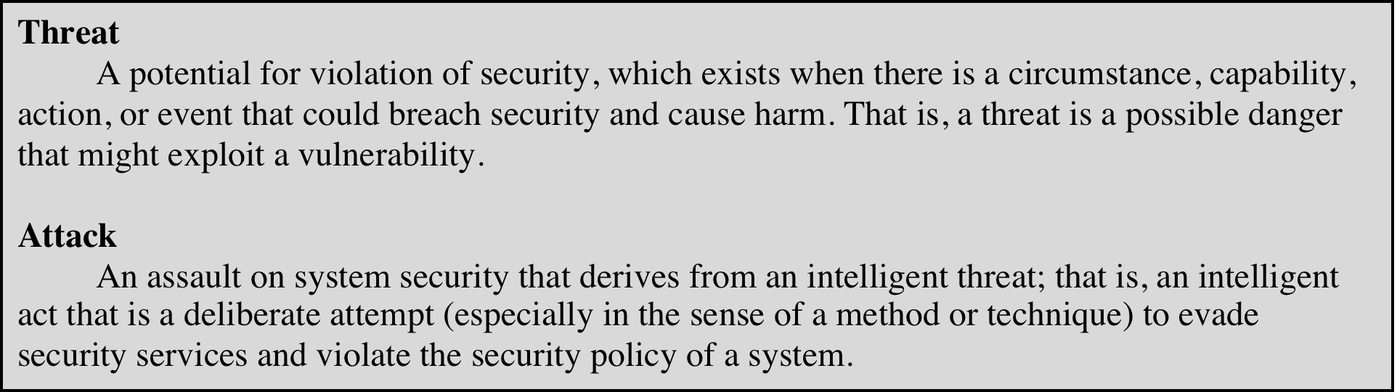
Threats and Attacks (RFC 4949)
Notes:
In the literature, the terms threat and attack are commonly used to mean more
or less the same thing. Table 1.1 provides definitions taken from RFC 4949, Internet
Security Glossary.

Slide 49
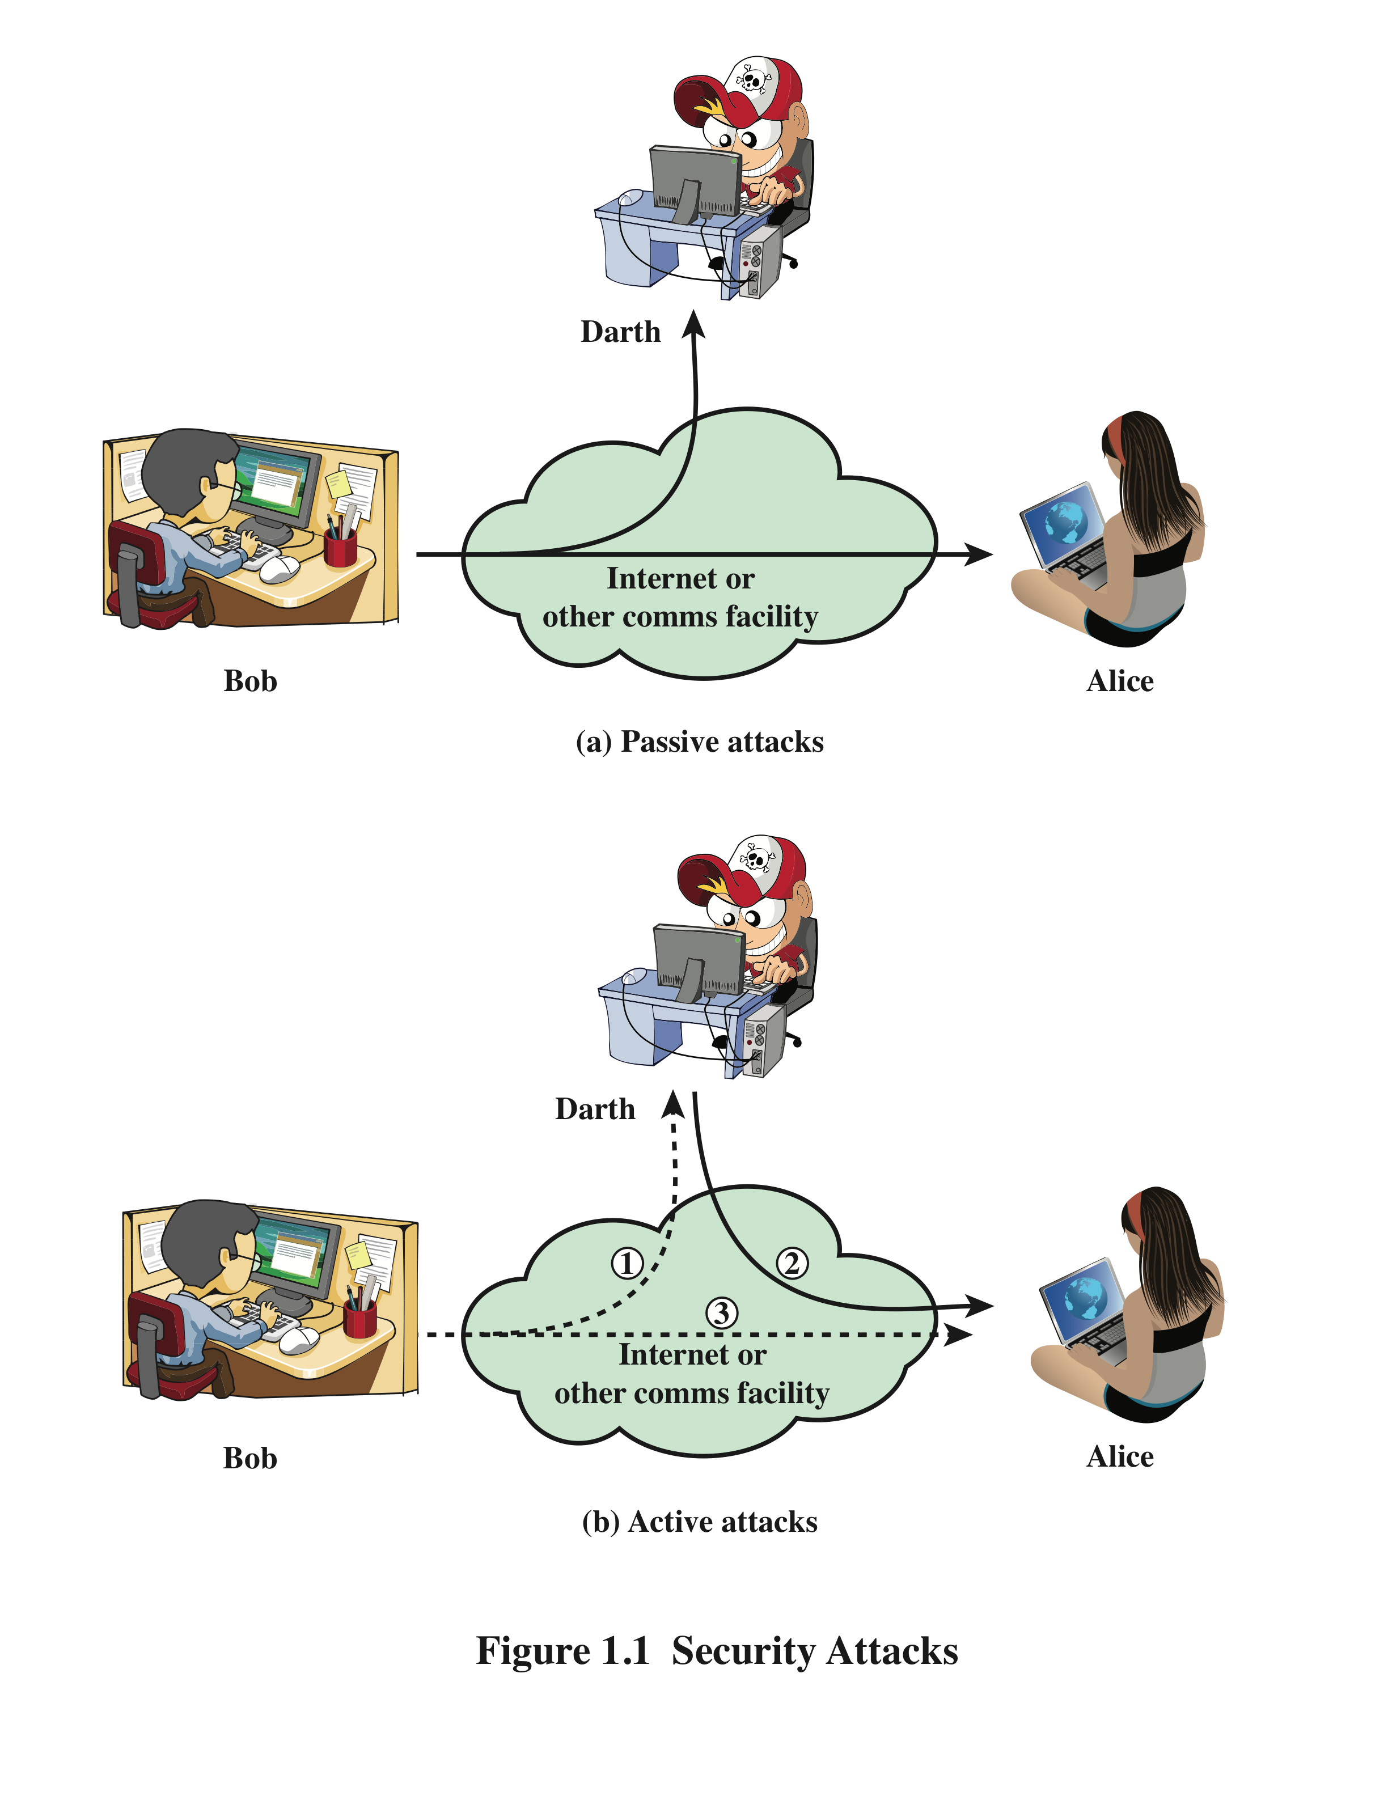
Security Attacks
A passive attack attempts to learn or make use of information from the system but does not affect system resources
An active attack attempts to alter system resources or affect their operation
Notes:
A useful means of classifying security attacks, used both in X.800 and RFC 4949, is in
terms of passive attacks and active attacks (Figure 1.1). A passive attack attempts to
learn or make use of information from the system but does not affect system resources.
An active attack attempts to alter system resources or affect their operation.

Slide 50
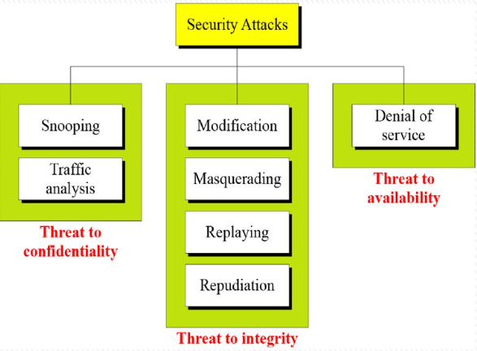
Attacks
The three goals of security- confidentiality, integrity, and availability- can be threatened by security attacks.

Slide 51
Attacks Threatening Confidentiality
Snooping refers to the unauthorized access to or interception of data.
Traffic analysis refers to obtaining some other type of information by monitoring online traffic.
Read contents of
message from Bob
to Alice
Observe pattern of
messages from Bob
to Alice
Snooping
Traffic analysis

Slide 52
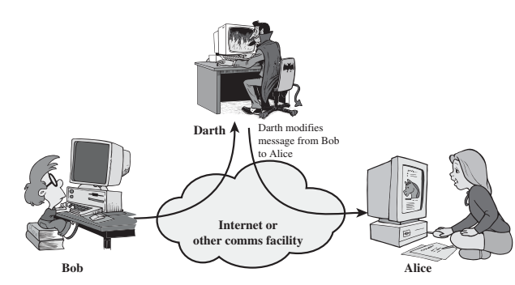
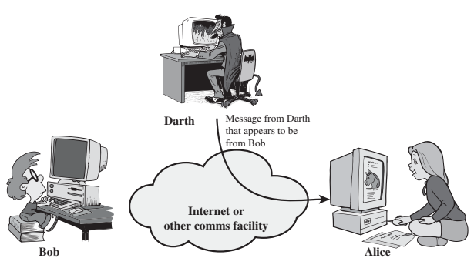
Attacks Threatening Integrity
Modification means that the attacker intercept the message and changes it.
Masquerading or spoofing happens when the attacker impersonate somebody else. Thus when one entity pretends to be a different entity.
Modification
Masquerade

Slide 53
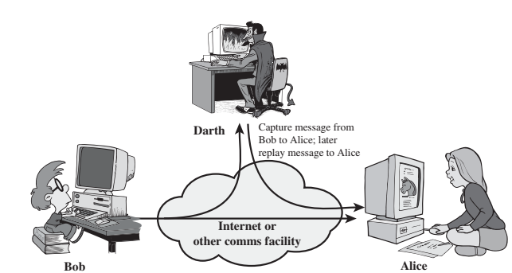
Attacks Threatening Integrity
Replaying means that the attacker obtains a copy of the message sent by a user and the later tries to replay it.
Repudiation means that the sender of the message might later deny that he/she has sent the message; likewise the receiver of the message might also deny receiving it.
Replay

Slide 54
Attacks Threatening Availability
Denial of service (DoS) is the most common attack. I may slow down or totally interrupt the service of a system.
Categorization of Passive Versus Active Attack
Attacks | Passive/Active | Threatening
Snooping Traffic analysis | Passive | Confidentiality
Modification Masquerading Replaying Repudiation | Active | Integrity
Denial of service | Active | Availability

Slide 55
Overview
Introduction
What’s distributed system？
What is distributed system security?
Why do we need security?
Security Services
Common security attacks and countermeasures
Firewalls & Intrusion Detection Systems
Denial of Service Attacks
TCP Attacks
Packet Sniffing
Social Problems

Slide 56
Security Services
Why Security Services
enhance security of data processing systems and information transfers of an organization.
intended to counter security attacks
using one or more security mechanisms
often replicates functions normally associated with physical documents
which, for example, have signatures, dates;
need protection from disclosure, tampering, or destruction;
be notarized or witnessed; be recorded or licensed
Notes:
Consider the role of a security service, and what may be required. Note both similarities and differences with traditional paper documents, which for example: have signatures & dates; need protection from disclosure, tampering, or destruction; may be notarized or witnessed; may be recorded or licensed

Slide 57
Security Services
Defined by X.800 as:
A service provided by a protocol layer of communicating open systems and that ensures adequate security of the systems or of data transfers.
Defined by RFC 4949 as:
A processing or communication service provided by a system to give a specific kind of protection to system resources.
Notes:
X.800 defines a security service as a service that is provided by a protocol layer of
communicating open systems and that ensures adequate security of the systems
or of data transfers. Perhaps a clearer definition is found in RFC 4949, which
provides the following definition: a processing or communication service that is
provided by a system to give a specific kind of protection to system resources;
security services implement security policies and are implemented by security
mechanisms.

Slide 58
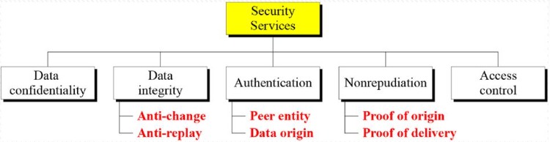
X.800 Service Categories
Data confidentiality
Data integrity
Authentication
Nonrepudiation
Access control
Notes:
X.800 divides these services into five categories.

Slide 59
Data Confidentiality
The protection of transmitted data from passive attacks
Broadest service protects all user data transmitted between two users over a period of time
Narrower forms of service include the protection of a single message or even specific fields within a message
The protection of traffic flow from analysis
This requires that an attacker not be able to observe the source and destination, frequency, length, or other characteristics of the traffic on a communications facility
Notes:
Confidentiality is the protection of transmitted data from passive attacks. With
respect to the content of a data transmission, several levels of protection can be
identified. The broadest service protects all user data transmitted between two
users over a period of time. For example, when a TCP connection is set up between
two systems, this broad protection prevents the release of any user data transmitted
over the TCP connection. Narrower forms of this service can also be defined,
including the protection of a single message or even specific fields within a message.
These refinements are less useful than the broad approach and may even be more
complex and expensive to implement.
The other aspect of confidentiality is the protection of traffic flow from analysis.
This requires that an attacker not be able to observe the source and destination, frequency,
length, or other characteristics of the traffic on a communications facility.

Slide 60
Data Integrity
Can apply to a stream of messages, a single message, or selected fields within a message
Connection-oriented integrity service deals with a stream of messages and assures that messages are received as sent with no duplication, insertion, modification, reordering, or replays
A connectionless integrity service deals with individual messages without regard to any larger context and generally provides protection against message modification only
Notes:
As with confidentiality, integrity can apply to a stream of messages, a single message,
or selected fields within a message. Again, the most useful and straightforward
approach is total stream protection.
A connection-oriented integrity service, one that deals with a stream of messages,
assures that messages are received as sent with no duplication, insertion,
modification, reordering, or replays. The destruction of data is also covered under
this service. Thus, the connection-oriented integrity service addresses both message
stream modification and denial of service. On the other hand, a connectionless integrity
service, one that deals with individual messages without regard to any larger
context, generally provides protection against message modification only.
We can make a distinction between service with and without recovery.
Because the integrity service relates to active attacks, we are concerned with detection
rather than prevention. If a violation of integrity is detected, then the service
may simply report this violation, and some other portion of software or human
intervention is required to recover from the violation. Alternatively, there are
mechanisms available to recover from the loss of integrity of data, as we will review
subsequently. The incorporation of automated recovery mechanisms is, in general,
the more attractive alternative.

Slide 61
Authentication
Concerned with assuring that a communication is authentic
In the case of a single message, assures the recipient that the message is from the source that it claims to be from
In the case of ongoing interaction, assures the two entities are authentic and that the connection is not interfered with in such a way that a third party can masquerade as one of the two legitimate parties
Two specific authentication services are defined in X.800:
Peer entity authentication
Data origin authentication
Notes:
The authentication service is concerned with assuring that a communication is
authentic. In the case of a single message, such as a warning or alarm signal, the
function of the authentication service is to assure the recipient that the message
is from the source that it claims to be from. In the case of an ongoing interaction,
such as the connection of a terminal to a host, two aspects are involved. First,
at the time of connection initiation, the service assures that the two entities are
authentic, that is, that each is the entity that it claims to be. Second, the service
must assure that the connection is not interfered with in such a way that a third
party can masquerade as one of the two legitimate parties for the purposes of
unauthorized transmission or reception.
Two specific authentication services are defined in X.800:
• Peer entity authentication: Provides for the corroboration of the identity
of a peer entity in an association. Two entities are considered peers if they
implement to same protocol in different systems; for example two TCP modules
in two communicating systems. Peer entity authentication is provided for
use at the establishment of, or at times during the data transfer phase of, a
connection. It attempts to provide confidence that an entity is not performing
either a masquerade or an unauthorized replay of a previous connection.
• Data origin authentication: Provides for the corroboration of the source of a
data unit. It does not provide protection against the duplication or modification
of data units. This type of service supports applications like electronic mail,
where there are no prior interactions between the communicating entities.

Slide 62

Nonrepudiation
Prevents either sender or receiver from denying a transmitted message
When a message is sent, the receiver can prove that the alleged sender in fact sent the message
When a message is received, the sender can prove that the alleged receiver in fact received the message
Notes:
Nonrepudiation prevents either sender or receiver from denying a transmitted message.
Thus, when a message is sent, the receiver can prove that the alleged sender in
fact sent the message. Similarly, when a message is received, the sender can prove
that the alleged receiver in fact received the message.

Slide 63
Access Control
The ability to limit and control the access to host systems and applications via communications links
To achieve this, each entity trying to gain access must first be indentified, or authenticated, so that access rights can be tailored to the individual
Notes:
In the context of network security, access control is the ability to limit and control
the access to host systems and applications via communications links. To achieve
this, each entity trying to gain access must first be identified, or authenticated, so
that access rights can be tailored to the individual.

Slide 64
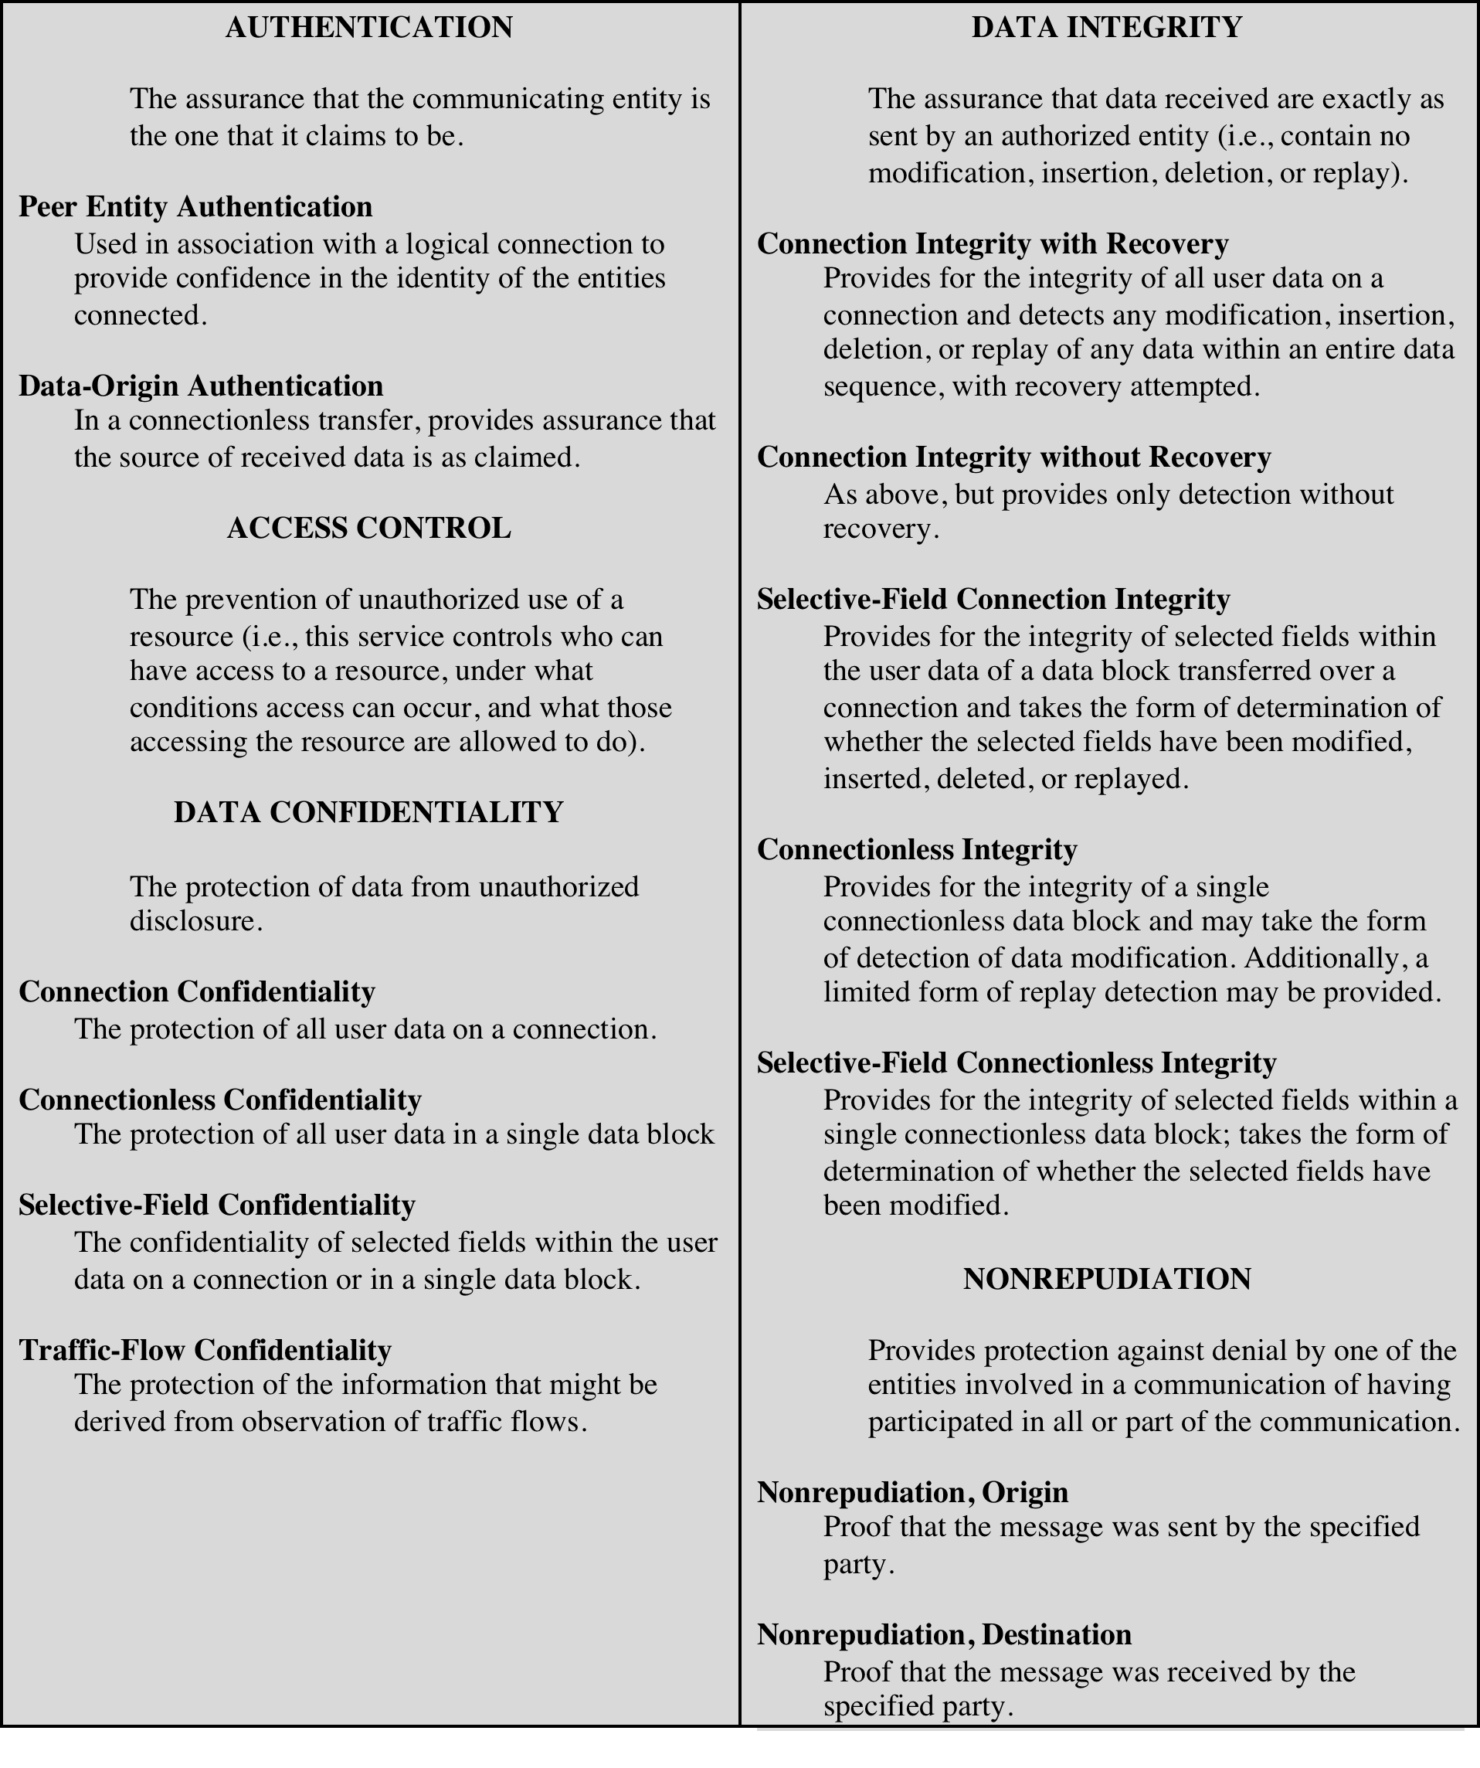
Security Services
(X.800)
Notes:
X.800 divides these services into five categories and fourteen specific services
(Table 1.2).

Slide 65
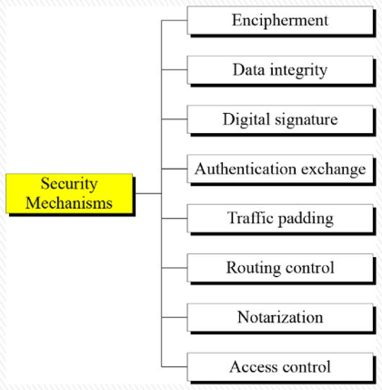
Security Mechanism
Notes:
Encipherment : hiding or covering data , can prove confidentiality , two techniques , cryptography and steganography .
Data integrity : appends to the data a short check value that has been created by a specific process from data itself.
Digital signature: the sender can electronically sign the data and receiver can verify the signature,
Authentication exchange: two entities exchange some message to prove their identity to each other.
Traffic Padding: inserting some bogus data into the traffic to thwart the adversary’s attempt to use traffic analysis.
Routing control: selecting and continuously changing different available routes between the sender and the receiver.
Notarization: selecting a third trusted party to control the communication between two entities ( to prevent repudiation )
Access control: uses a method to prove that the user has access right to the data or resources owned by system (PINs or password)

Slide 66
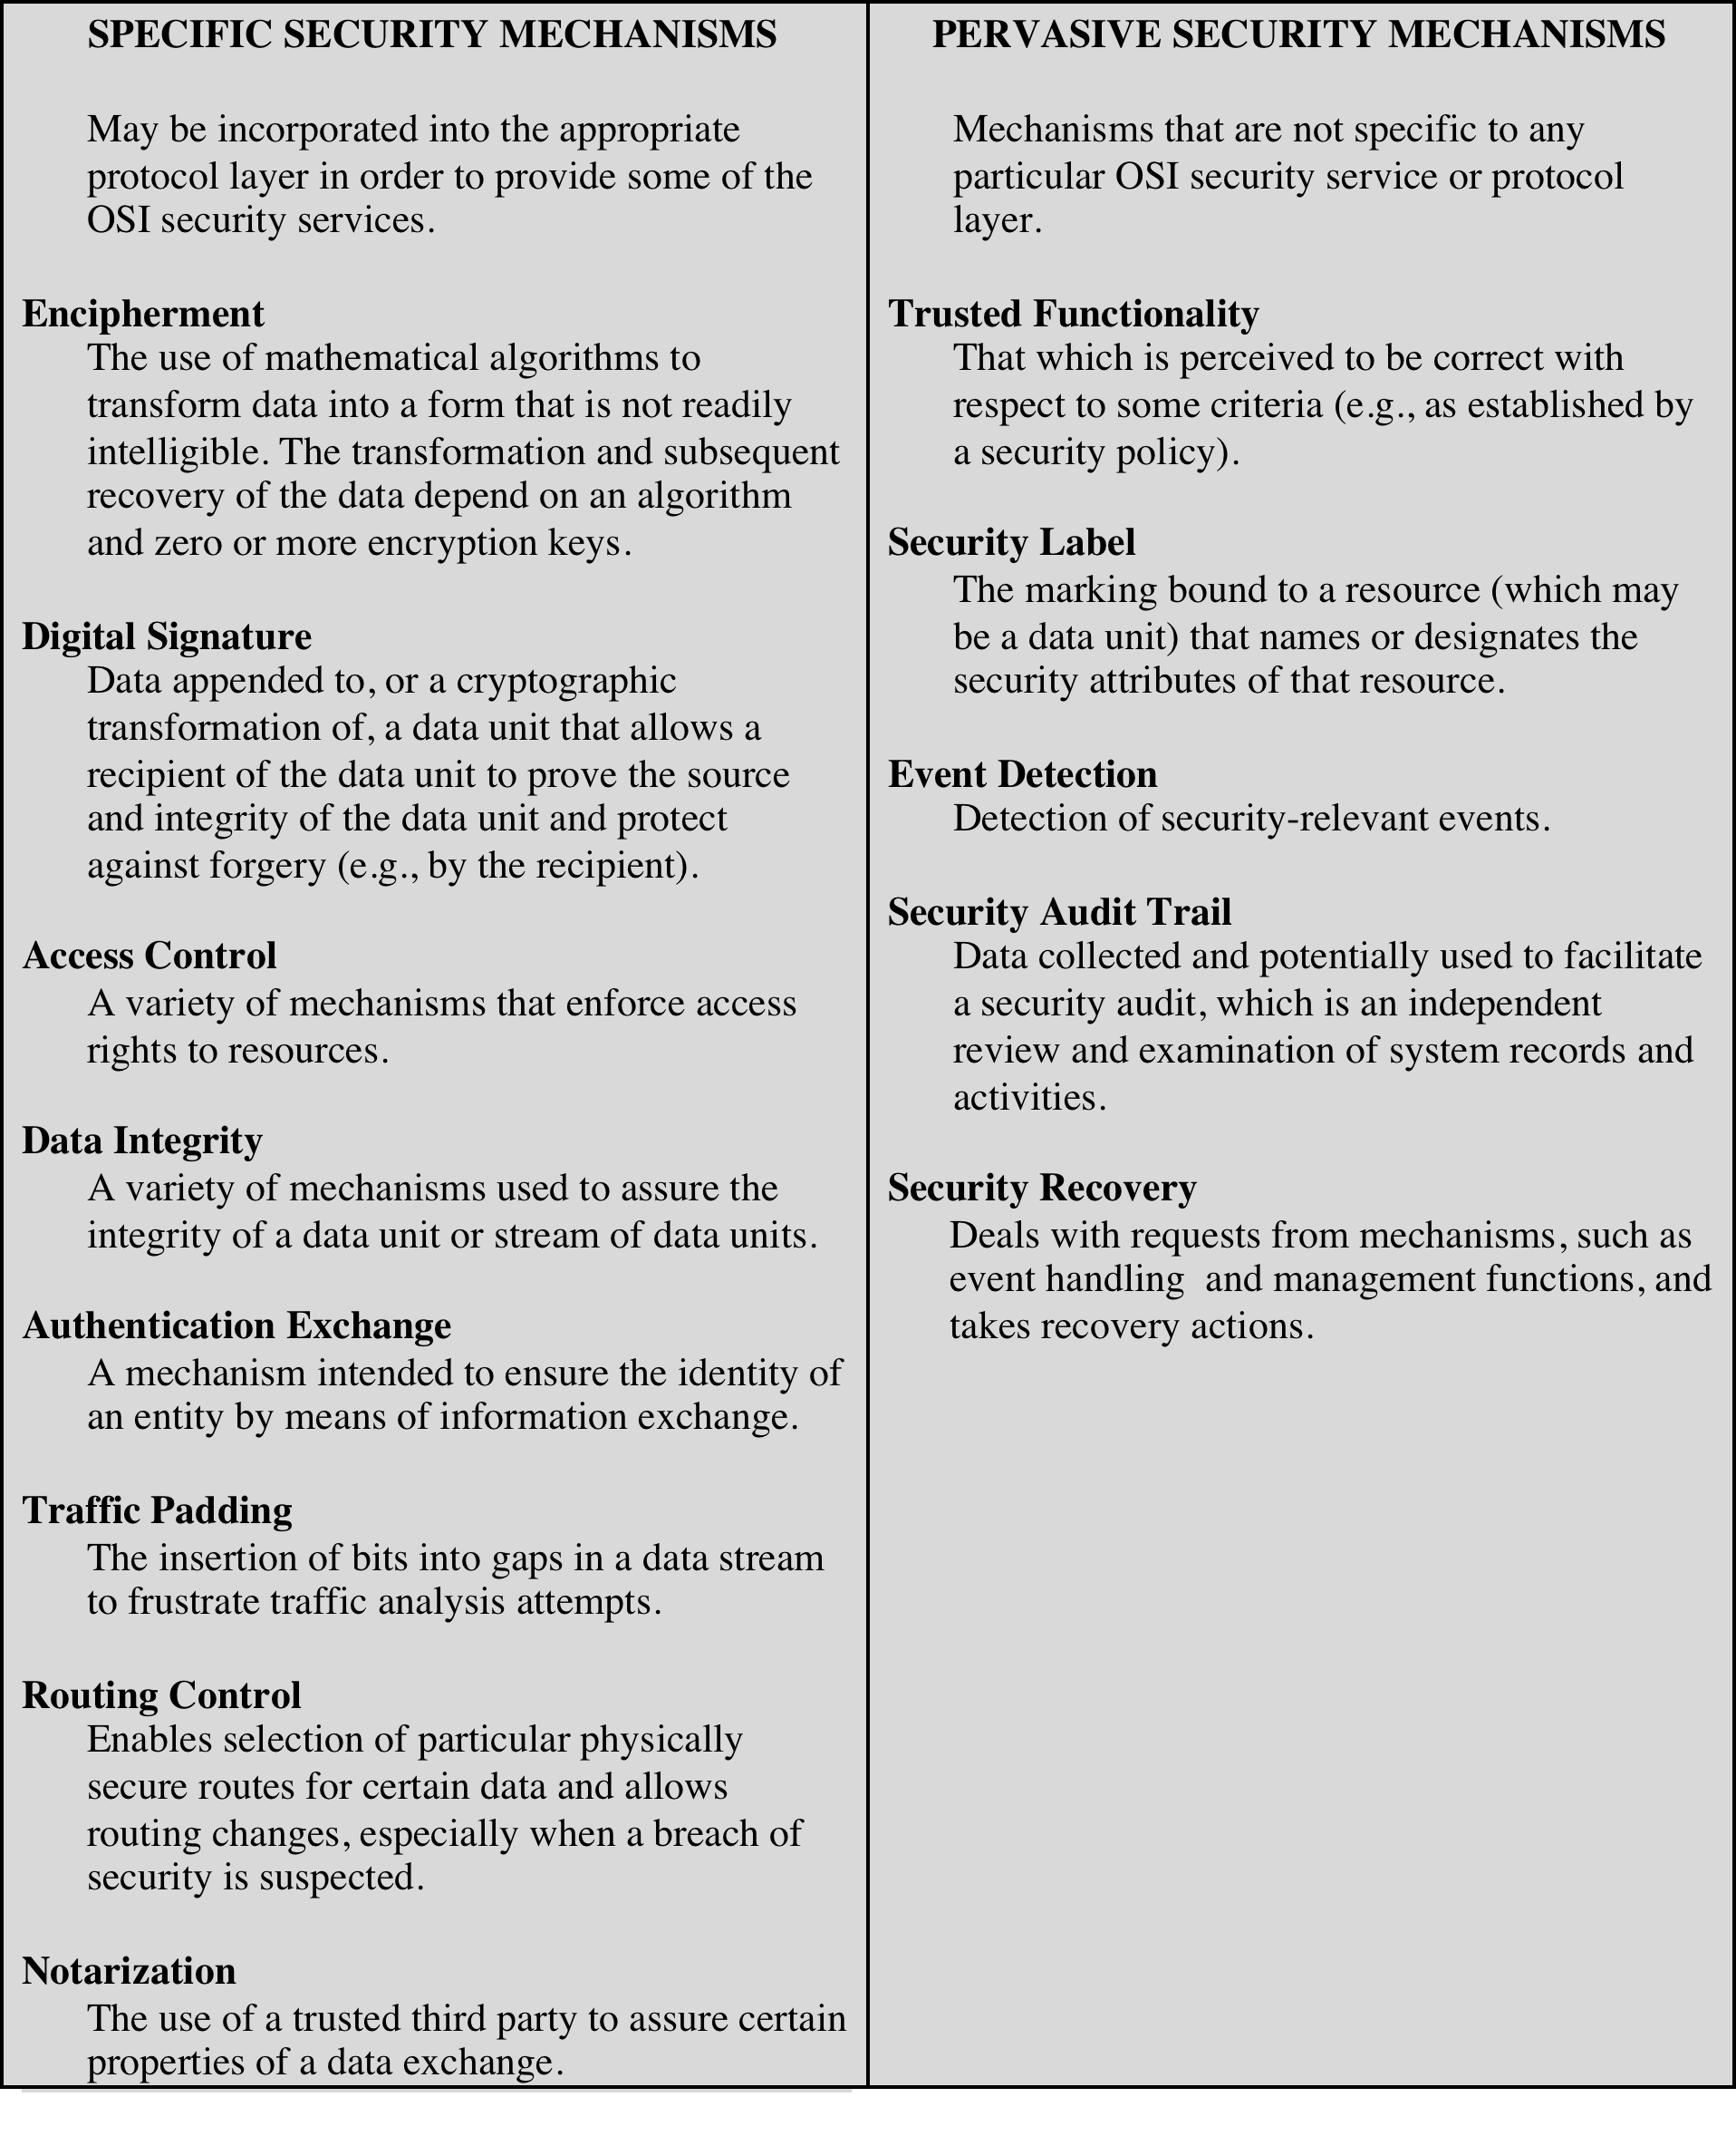
Security Mechanisms
(X.800)
Notes:
Table 1.3 lists the security mechanisms defined in X.800. The mechanisms are
divided into those that are implemented in a specific protocol layer, such as TCP
or an application-layer protocol, and those that are not specific to any particular
protocol layer or security service. These mechanisms will be covered in the
appropriate places in the book, so we do not elaborate now except to comment
on the definition of encipherment. X.800 distinguishes between reversible
encipherment mechanisms and irreversible encipherment mechanisms. A reversible
encipherment mechanism is simply an encryption algorithm that allows data to
be encrypted and subsequently decrypted. Irreversible encipherment mechanisms
include hash algorithms and message authentication codes, which are used in digital
signature and message authentication applications.

Slide 67
Relation between Services and Mechanisms
Security Services | Security Mechanisms
Data confidentiality | Encipherment and routing control
Data integrity | Encipherment, digital signature and data integrity
Authentication | Encipherment, digital signature and authentication exchange
Nonrepudiation | Digital signature, data integrity and notarization
Access control | Access control mechanism
Notes:
Encipherment : hiding or covering data , can prove confidentiality , two techniques , cryptography and steganography .
Data integrity : appends to the data a short check value that has been created by a specific process from data itself.
Digital signature: the sender can electronically sign the data and receiver can verify the signature,
Authentication exchange: two entities exchange some message to prove their identity to each other.
Traffic Padding: inserting some bogus data into the traffic to thwart the adversary’s attempt to use traffic analysis.
Routing control: selecting and continuously changing different available routes between the sender and the receiver.
Notarization: selecting a third trusted party to control the communication between two entities ( to prevent repudiation )
Access control: uses a method to prove that the user has access right to the data or resources owned by system (PINs or password)

Slide 68
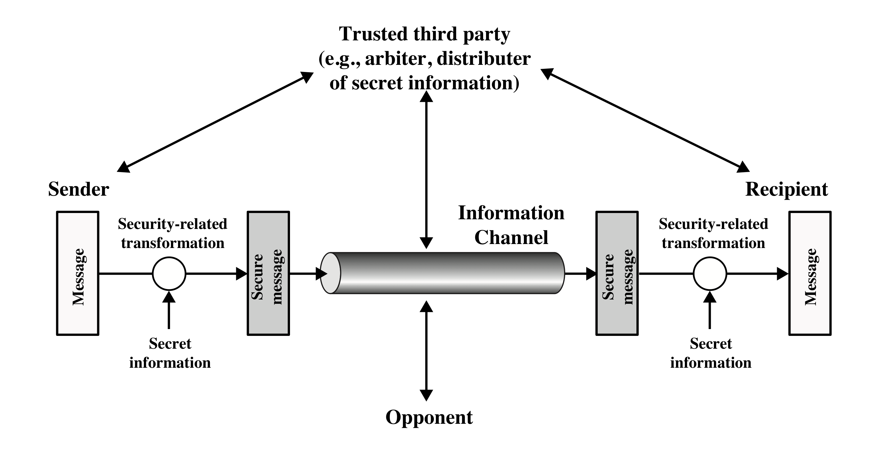
Model for Network Security
Notes:
A model for much of what we will be discussing is captured, in very general terms,
in Figure 1.2. A message is to be transferred from one party to another across some
sort of Internet service. The two parties, who are the principals in this transaction,
must cooperate for the exchange to take place. A logical information channel is
established by defining a route through the Internet from source to destination
and by the cooperative use of communication protocols (e.g., TCP/IP) by the two
principals.
Security aspects come into play when it is necessary or desirable to protect the
information transmission from an opponent who may present a threat to confidentiality,
authenticity, and so on. All of the techniques for providing security have two
components:
1. A security-related transformation on the information to be sent. Examples
include the encryption of the message, which scrambles the message so that it
is unreadable by the opponent, and the addition of a code based on the contents
of the message, which can be used to verify the identity of the sender.
2. Some secret information shared by the two principals and, it is hoped,
unknown to the opponent. An example is an encryption key used in conjunction
with the transformation to scramble the message before transmission and
unscramble it on reception.
A trusted third party may be needed to achieve secure transmission. For
example, a third party may be responsible for distributing the secret information
to the two principals while keeping it from any opponent. Or a third party may be
needed to arbitrate disputes between the two principals concerning the authenticity
of a message transmission.

Slide 69
Model for Network Security
Using this model requires us to:
design a suitable algorithm for the security transformation
generate the secret information (key) to be used with the algorithm
develop methods to distribute and share the secret information
specify a protocol enabling the principals to use the transformation and secret information for a security service
Notes:
This general model shows that there are four basic tasks in designing a
particular security service:
1. Design an algorithm for performing the security-related transformation. The
algorithm should be such that an opponent cannot defeat its purpose.
2. Generate the secret information to be used with the algorithm.
3. Develop methods for the distribution and sharing of the secret information.
4. Specify a protocol to be used by the two principals that make use of the security
algorithm and the secret information to achieve a particular security service.

Slide 70
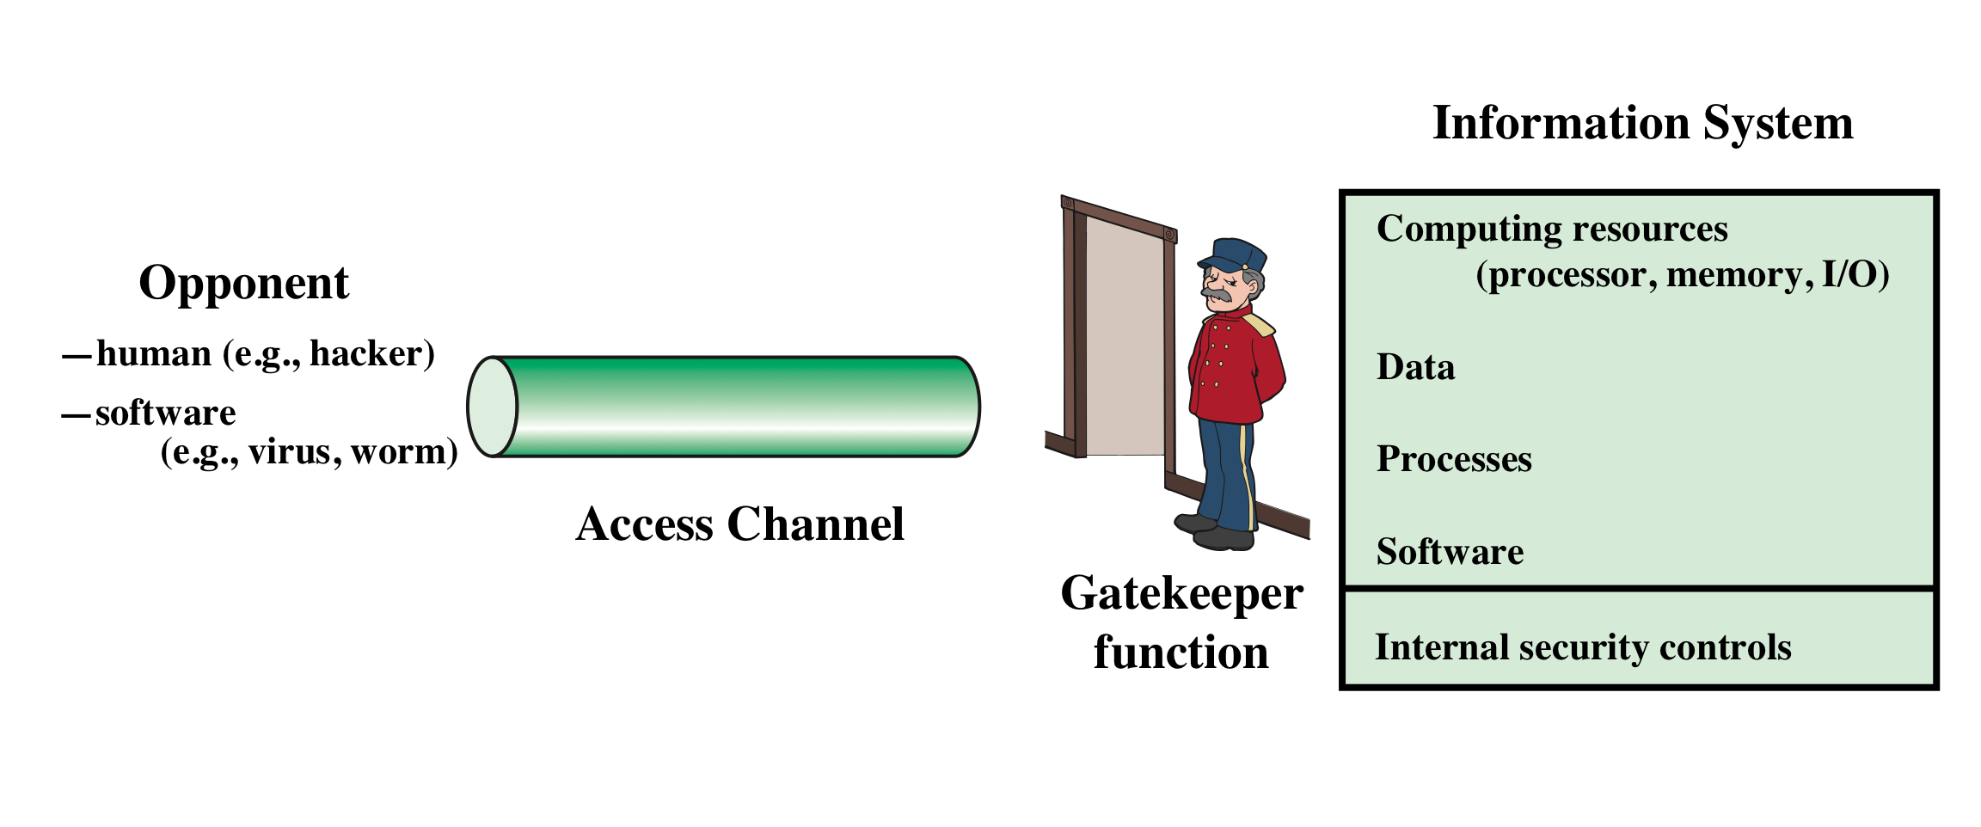
Network Access Security Model
Using this model requires :
select appropriate gatekeeper functions to identify users
implement security controls to ensure only authorized users access designated information or resources
Notes:
Most readers are familiar with the concerns caused by the existence
of hackers who attempt to penetrate systems that can be accessed over a network.
The hacker can be someone who, with no malign intent, simply gets satisfaction
from breaking and entering a computer system. The intruder can be a disgruntled
employee who wishes to do damage or a criminal who seeks to exploit computer
assets for financial gain (e.g., obtaining credit card numbers or performing illegal
money transfers).
The security mechanisms needed to cope with unwanted access fall into two
broad categories (see Figure 1.3). The first category might be termed a gatekeeper
function. It includes password-based login procedures that are designed to deny
access to all but authorized users and screening logic that is designed to detect
and reject worms, viruses, and other similar attacks. Once either an unwanted user
or unwanted software gains access, the second line of defense consists of a variety
of internal controls that monitor activity and analyze stored information in an
attempt to detect the presence of unwanted intruders. These issues are explored in
Part Three.

Slide 71
Unwanted Access
Placement in a computer system of logic that exploits vulnerabilities in the system and that can affect application programs as well as utility programs
Programs can present two kinds of threats:
Information access threats
Intercept or modify data on behalf of users who should not have access to that data
Service threats
Exploit service flaws in computers to inhibit use by legitimate users
Notes:
Another type of unwanted access is the placement in a computer system
of logic that exploits vulnerabilities in the system and that can affect application
programs as well as utility programs, such as editors and compilers. Programs can
present two kinds of threats:
1. Information access threats: Intercept or modify data on behalf of users who
should not have access to that data.
2. Service threats: Exploit service flaws in computers to inhibit use by legitimate
users.
Viruses and worms are two examples of software attacks. Such attacks can be
introduced into a system by means of a disk that contains the unwanted logic concealed
in otherwise useful software. They also can be inserted into a system across a
network; this latter mechanism is of more concern in network security.

Slide 72
Done for Today
Next…
Common security attacks and countermeasures

